Slide 1
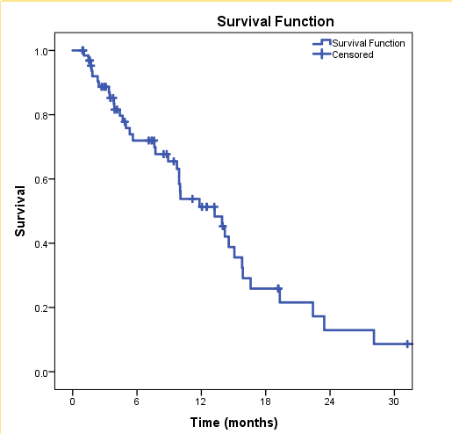
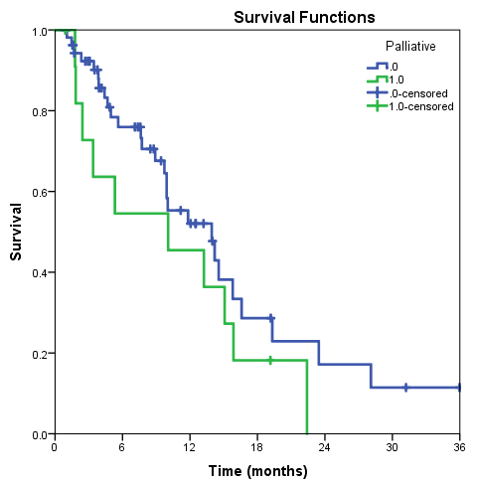
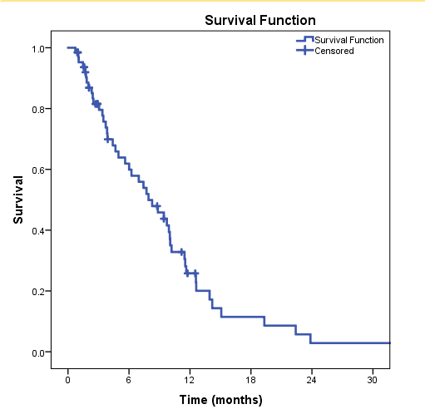
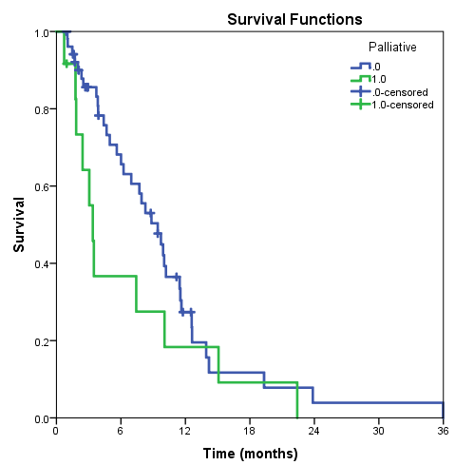
Clinical Outcomes of Patients with Recurrent Lung Cancer Re-irradiated with Proton Therapy on the Proton Collaborative Group Prospective Registry Trial
S.N. Badiyan¹, P. Mohindra¹, G. Larson², W. Hartsell³, H. Tsai⁴, J. Zeng⁵, R. Rengan⁵, B. Wilkinson⁶, C. Vargas⁷, S. Feigenberg¹, C. B. Simone¹
1. University of Maryland and Maryland Proton Treatment Center 2. Oklahoma Procure Proton Therapy Center 3. Northwestern Medicine Chicago Proton Center 4. New Jersey Procure Proton Therapy Center 5. University of Washington and Seattle Cancer Care Alliance Proton Therapy Center 6. Willis-Knighton Proton Therapy Center7. Mayo Clinic Arizona Proton Therapy Program
Purpose/Objectives:
Following radiation therapy (RT) for lung cancer up to 50% of patients may develop a locoregional recurrence.
Treatment options are limited for locoregionally recurrent lung cancer and outcomes poor with median OS of 3-15 months.
Re-irradiation with proton beam therapy (PBT) may be safer and better tolerated than photon RT but data on patient outcomes is limited.
Results:
Table 1. Patient and Tumor Characteristics
Table 3. Proton Beam Reirradiation Characteristics
Figure 1. Overall Survival for all patients (A) and stratified by definitive or palliative dose of PBT (EQD2 50 Gy cutoff) (B).
A B
Characteristic | N=67 (%)
Median time from prior RT to PBT | 20 mo. (2.2 – 265 mo)
Median PBT dose (Gy(RBE)) (range) | 60 Gy (30-74 Gy, 1.2-6 Gy/fx)
Palliative dose (EQD2 < 50 Gy(RBE)) | 12 (18%)
Definitive dose (EQD2 > 50 Gy(RBE)) Conventionally fractionated Hyperfractionated Hypofractionated | 55 (82%) 37 (67%) (50-74 Gy, 1.8-2 Gy/fx) 2 (4%) (64.8-70 Gy, 1.2-1.23 Gy/fx BID) 16 (29%) (40-60 Gy, 2.25-6 Gy/fx)
Concurrent chemotherapy | 20 (30%)
Completed course of PBT | 67 (100%)
Median follow-up (months) (range) | 7.6 mo (1-36 mo)
Characteristic | N=67 (%)
Median age at 1st RT (range) Median age at PBT Re-RT (range) | 66 (39-87) 68 (41-89)
Female | 29 (43%)
White Black Other Not Reported | 55 (82%) 7 (10%) 2 (3%) 3 (4%)
Current smoker Former smoker Non-smoker Not Reported | 11 (16%) 54 (81%) 1 (1%) 1 (1%)
ECOG PS at PBT 0 1 2 3 Not Reported | 31 (46%) 25 (37%) 6 (9%) 2 (3%) 3 (4%)
NSCLC SCLC | 60 (90%) 7 (10%)
Definitive
Palliative
Methods:
67 patients reirradiated with PBT from 2010-2016 at six PCG institutions
Toxicity and outcomes prospectively recorded and reported to the Proton Collaborative Group (PCG)
CTCAE v 4.0
Survival estimated using Kaplan Meier and log rank statistics
Median overall survival (OS) was 13.2 months. One and 2-year OS was 51%, and 13% (Figure 1A). Median OS for patients receiving a definitive dose of PBT was 13.9 months and 10.1 months for patients receiving palliative dose of PBT (p=0.24) (Figure 1B). One and 2-year OS was 52% and 17% for patients receiving a definitive dose and 46% and 0% for patients receiving a palliative dose, respectively.
Figure 2. Progression-Free Survival for all patients (A) and stratified by definitive or palliative dose of PBT (EQD2 50 Gy cutoff) (B).
A B
Table 2. Initial Radiation Therapy Characteristics
Median progression-free survival (PFS) was 7.9 months. One and 2-year PFS was 26% and 3% (Figure 2A). Median PFS for patients receiving a definitive dose of PBT was 9.4 months and 3.4 months for patients receiving palliative dose of PBT (p=0.16) (Figure 2B). One and 2-year PFS was 27% and 4% for patients receiving a definitive dose and 18% and 0% for patients receiving a palliative dose, respectively.
Characteristic | N=67 (%)
Courses of RT before PBT 1 2 3 | 60 (90%) 6 (9%) 1 (1%)
Conventional fractionation Median Dose (range) SBRT Median Dose (range) | 53 (79%) 59.4 Gy (30-74 Gy, 10-37 fx) 14 (21%) 50 Gy (35-64 Gy, 3-5 fx)
Chemotherapy prior to PBT | 56 (84%)
Lung resection prior to PBT | 23 (35%)
Table 4. Acute and Late Toxicities after PBT reirradiation
Acute Toxicity | Select Grade 2 n (%) | Grade 3 n (%) | Grade 4 n (%) | Grade 5 n (%)
Dyspnea | 5 (7%) | - | - | -
Pneumonitis | - | - | - | -
Esophagitis | 9 (13%) | - | - | -
Pneumonia | - | 1 (2%) | - | -
Neck Pain | - | 1 (2%) | - | -
Definitive
Palliative
Late Toxicity
Dyspnea | 4 (6%) | - | - | -
Pneumonitis | 1 (2%) | - | - | -
Esophagitis | - | - | - | -
Fatigue | - | 1 (2%) | - | -
Cardiac Arrest | - | - | - | 1 (2%)
Conclusions:
Despite delivery to a high-risk, heavily pre-treated,
previously irradiated population, proton therapy for
recurrent lung cancer resulted in limited toxicity.
All patients were able to complete the entire prescribed
course of proton therapy.
Future analyses are needed to determine ideal re-irradiation
dose and fractionation scheme and factors associated with
toxicity and local tumor control

