Slide 1
Hypofractionated Vs. Standard Fractionation Proton Therapy For Prostate Cancer: PCG GU002-10
William Hartsell, M.D.
Medical Director
CDH Proton Center – A ProCure Center
Warrenville, Illinois USA

Slide 2
Hypofractionated Vs. Standard Fractionation Proton Therapy For Prostate Cancer: PCG GU002-10
Carlos Vargas¹, William Hartsell², Kimberly Hahn³, Doug Smidebush³, John Han-Chih Chang², Lori Abruscato², Angela Piper³, Sameer Keole⁴ ¹Florida Radiation Oncology Group, Jacksonville, FL, USA ²CDH Proton Center - A ProCure Center, Warrenville, IL, USA ³Proton Collaborative Group, Bloomington, IN, USA ⁴ProCure Proton Therapy Center, Oklahoma City, OK, USA

Slide 3
The Physics of Protons
Depth Dose Curves for Different Treatment Types
High Energy X-Rays
Spread Out Bragg Peak (SOBP)
100
80
Relative Dose
60
40
200 MeV Protons
20
Healthy Tissue
Tumor
Healthy Tissue
0
0
5
10
15
20
25
30
Depth in Tissue (cm)
Notes:
Chris
The Chris / IBA rap
The improved dose distributions of protons, as compared to x-rays, allows increased dose delivered to the target volume, translating into improved local control.
Reduced dose to non-involved organs and tissues translates into reduced treatment morbidity and improved quality of life; reduced co-morbidity of multi-modality treatments, leading to improved treatment intensity and compliance.
Improved local control of malignancies translates into increased probability of survival for a significant proportion of patients.

Slide 4
Methods
Patients with clinical Stage I (T1c-T2a, PSA<10, Gleason <6) adenocarcinoma of the prostate were entered onto an IRB approved, multi-institutional trial. Eligible patients were randomly assigned to receive either 79.2 CGE in 44 fractions (1.8 CGE per day – Arm I) versus 38 CGE in 5 fractions (7.6 CGE per day – Arm II).
All patients had placement of fiducial markers prior to treatment planning. Planning consisted of treatment planning CT scan, with a pelvic MRI obtained (external coils only) to better define the boundaries of the prostate gland. Eligibility requirement included informed consent, AUA symptom score < 16. After treatment, patients are followed with PSA readings and EPIC quality of life indices at 3 months, 6 months and then every 6 months.
PTV was defined as 2mm-3mm around the prostate. An eval-PTV was included the PTV with a 5mm in the lateral expansion. Field design was optimized for 95% coverage of the eval-PTV. All patients were treated with daily marker based IGRT. Most patients had MRI soft tissue registration.

Slide 6
Results
The study was opened in Chicago in December, 2010, and in Oklahoma City in August, 2011. As of February 10, 2012, a total of 24 patients have been accrued to the study. Fifteen patients have completed treatment and have undergone review of acute toxicity during treatment.
Minor changes in the proximal and/or, distal margin, MRI registration, or prostate contouring were done for almost all cases during QA external review before treatment. However, none of them would have produced target under-dosage. All patients completed treatment as specified in the protocol without any major violations.

Slide 7
Results
All 15 patients had Grade 0-1 genitourinary and gastrointestinal toxicity. Six patients (3/8 in Arm I and 3/7 in Arm II) experienced grade 2 toxicity (primarily dermatitis or fatigue). There has been no grade 3 or higher acute toxicity.
For all patients acute toxicity was minimal with no grade 2 or higher GU AE other than the use of alpha blockers during treatment in 23% (5/22) of patients. No grade 2 or higher GI AE were seen. Hyperpigmentation/redness was seen in 2 patients. No grade 3 or higher AE were seen. AUA score returned to baseline before the first follow up (see table). AUA and EPIC scores were unchanged for both arms compared to baseline (see table) except for the EPIC sexual domain. Sexual QOL is multifactorial and relative changes can be seen with a sensitive instrument. However, longer follow up and larger cohort will be necessary to define real changes over time in this domain.

Slide 8
Standard course vs hypofractionated protons for prostate cancer
 | Baseline | 3 mo | 6 mo
AUA Symptom Score
Arm A | 4.3 | 3.3 | 7.0
Arm B | 5.7 | 5.8 | 7.7

Slide 9
Standard course vs hypofractionated protons for prostate cancer
 | Baseline | 3 mo | 6 mo
EPIC GU
Arm A | 85 | 86 | 83
Arm B | 88 | 81 | 88

Slide 10
Standard course vs hypofractionated protons for prostate cancer
 | Baseline | 3 mo | 6 mo
EPIC GI
Arm A | 98 | 90 | 94
Arm B | 94 | 93 | 93

Slide 11
Standard course vs hypofractionated protons for prostate cancer
 | Baseline | 3 mo | 6 mo
EPIC Sexual
Arm A | 67 | 77 | 58
Arm B | 52 | 45 | 61

Slide 12
Standard course vs hypofractionated protons for prostate cancer
 | Baseline | 3 mo | 6 mo
EPIC Hormonal
Arm A | 99 | 98 | 95
Arm B | 93 | 88 | 95

Slide 13
Conclusions
Patients have completed the study treatment thus far with no untoward acute toxicity. None of the patients has experienced grade 2 or higher acute GI or GU toxicity.
We continue to accrue patients to the study. Based on the initial results showing no significant difference in acute toxicity, we have modified the randomization to a 2:1 ratio (2 patients randomized to Arm A [5 fractions] for every one patient randomized to Arm B [standard arm – 44 fractions]). This allows for a smaller number of patients to reach the intended endpoints. There will be a total expected accrual of 197 patients over the next 2 years.

Slide 14
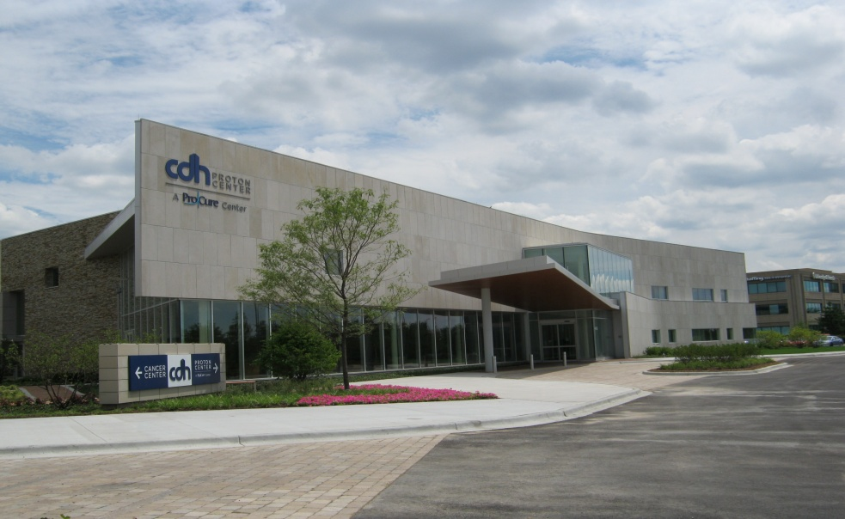
The CDH Proton Center, A Procure Center, Warrenville, IL

Slide 15
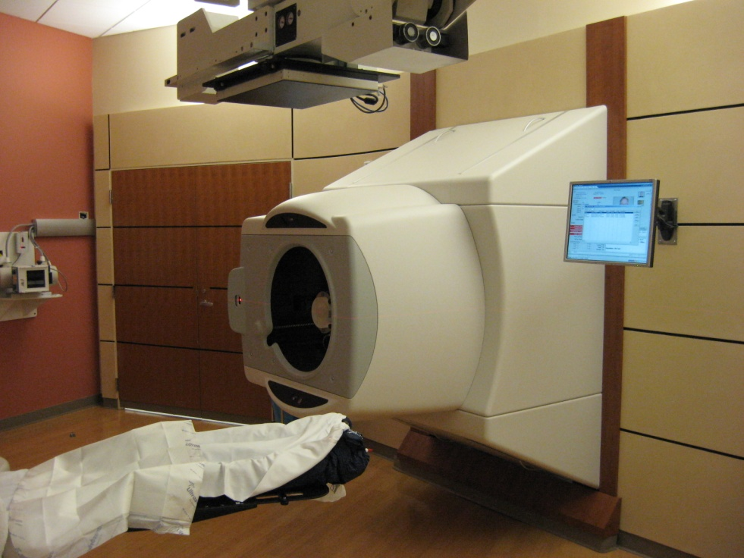
Treatment Rooms
Notes:
15

Slide 16
ProCure Treatment Centers, Inc. content is provided for informational and educational purposes only, and is not intended as medical advice, nor is it intended to create any physician-patient or clinical relationship. Please remember that this information should not substitute for a visit or a consultation with a healthcare provider. The views or opinions expressed in the resources provided do not necessarily reflect those of ProCure Treatment Centers, Inc.

