Slide 1
Multi-institutional outcomes of proton beam therapy for hepatocellular carcinoma from the Proton Collaborative Group REG001-09 study
Michael D. Chuong, MD¹; Amanda Zakka, BS²; Muni Rubens, MPH, MBBS, PhD¹; Arpit Chhabra, MD; Jason Molitoris, MD, PhD⁴; Jonathan Ashman, MD⁵; Nasir Mohammed, MD⁶; John Chang, MD⁷; James Urbanic, MD⁸; Henry Tsai, MD ⁹; Michael Eblan, MD ¹⁰; Smith Apisarnthanarax, MD ¹¹
¹Miami Cancer Institute, Miami FL; ²Florida International University, Miami FL; ³New York Proton Center, New York NY; ⁴Maryland Proton Treatment Center, Baltimore MD; ⁵Mayo Clinic, Scottsdale AZ; ⁶Northwestern Medicine, Warrenville IL; ⁷Oklahoma Proton Center, Oklahoma City OK; ⁸California Protons Cancer Therapy Center, San Diego CA; ⁹ProCure Proton Therapy Center, Somerset NJ; ¹⁰Inova Mather Proton Therapy Center, Fairfax VA; ¹¹Seattle Cancer Care Alliance Proton Therapy Center

Slide 2

Disclosures
Honoraria
ViewRay
Sirtex
IBA
Research Funding
ViewRay
Novocure
StratPharma
Leadership Positions
Proton Collaborative Group – Board of Directors
Proton Collaborative Group – Disease Site Committee Chair

Slide 3
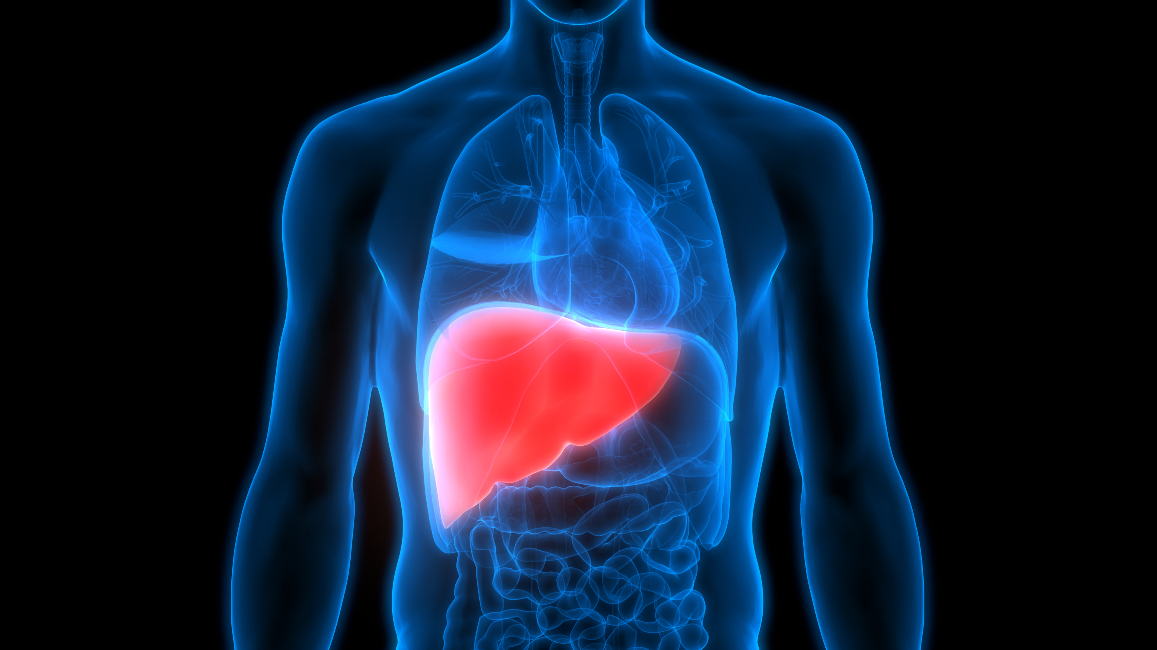
Normal Liver Tolerance
Radiosensitive organ
Parallel function
RILD factors
  Cirrhosis
  Baseline liver function
  Functional status of uninvolved liver
  Volume of uninvolved liver
  Prior therapy

Slide 4
QUANTEC
Mean and low liver dose
Pan et al. IJROBP 2010;76(3):S94-S100

Slide 5
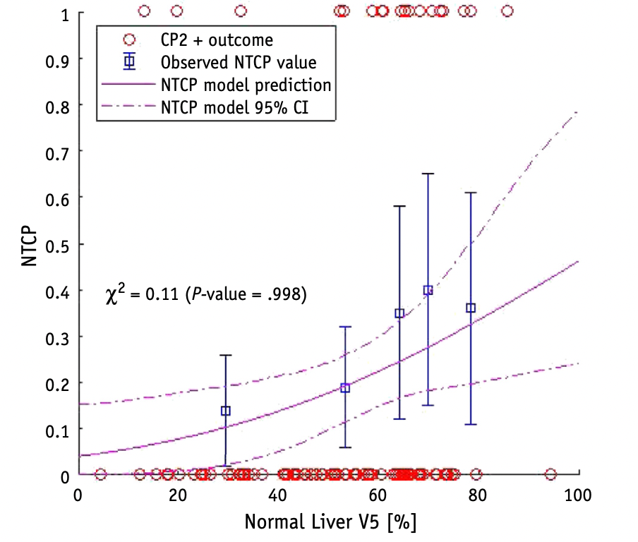
Low dose matters (MGH)
108 HCC patients
  Photon 56%
  Proton 44%
Fractionation
  SBRT 27% (median 43 Gy/5 fx)
  Mod hypofx 73% (median 59 Gy/15 fx)
CP2+ 3 months after RT
  Strongest correlation w/ V5-V10
  No correlation w/ MLD
    Subset analyses consistent w/ full model: excluded CP A, LRF w/I 6 months)
  Recommended liver V5 <60%
Pursley et al, IJROBP 2020

Slide 6
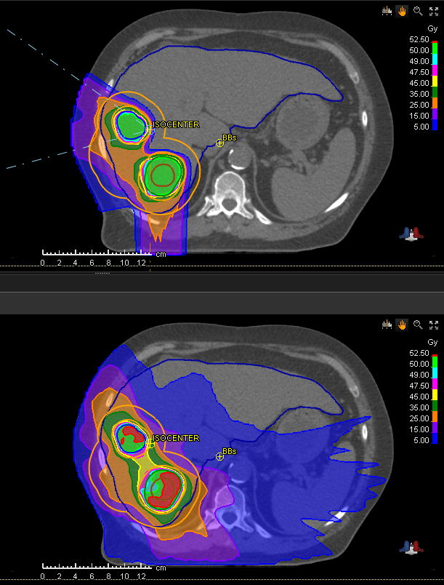

Slide 7
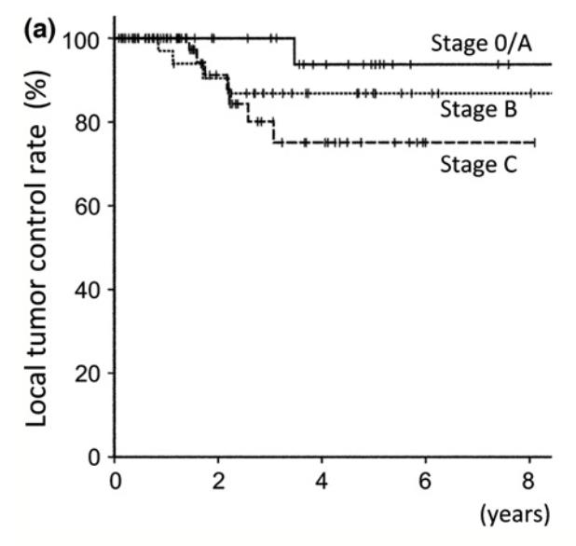
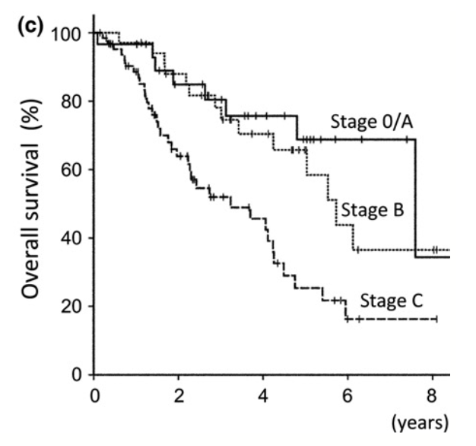
Tsukuba - 2017
129 untreated HCC patients
CP A/B: ~80%/~20%
Median 3.9 cm
Respiratory gating
3 dosing regimens
  <2 cm from GI organ: 77 GyE/35 fx
  <2 cm from porta hepatis: 72.6/22 fx
  All others: 66 GyE/10 fx
Median follow-up 55 months
Fukuda et al. Cancer Sci 2017;108:497-503

Slide 8
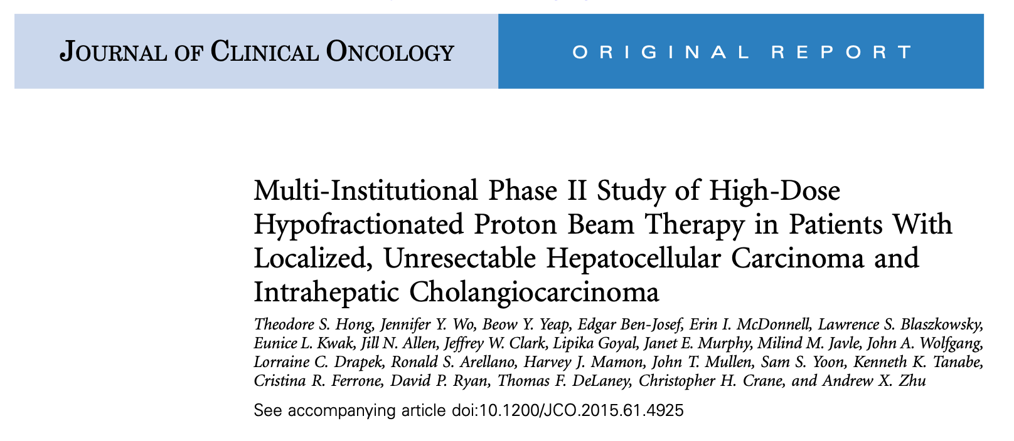
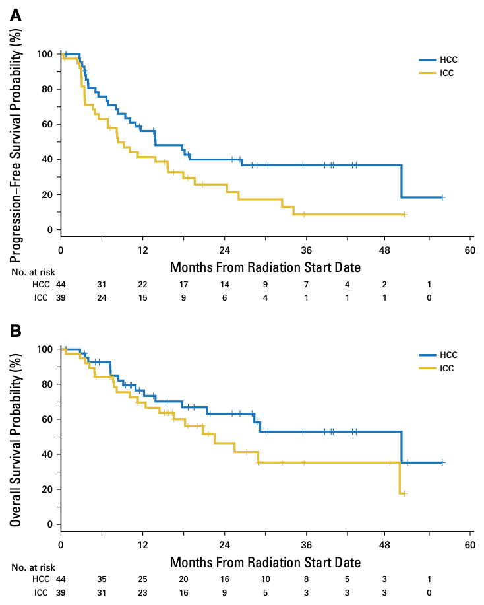
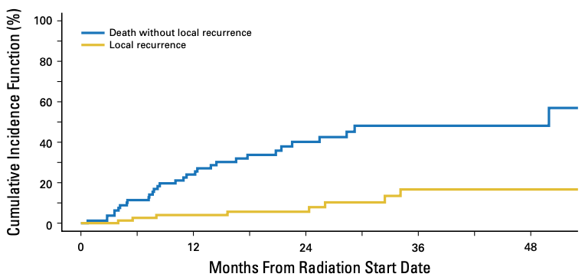
2-yr PFS 39.9%
67.5 GyE or 58.05 GyE in 15 fractions
2-yr OS 63.2%
2-yr LC 94.8%

Slide 9
Methods
We evaluated patients enrolled on the Proton Collaborative Group REG001-09 prospective registry study (NCT01255748)
Inclusion criteria
  Hepatocellular carcinoma
  No distant metastases
  Definitive proton therapy
  At least 2 month follow up after proton therapy
  Prior therapy permitted
Study objectives included:
  Freedom from local progression (FFLP)
  Freedom from intrahepatic progression (FFIP)
  Freedom from distant progression (FFDP)
  Progression-free survival (PFS)
  Overall survival (OS)
  Acute (within 3 months of PBT) and late toxicity (CTCAE v4.0)

Slide 10








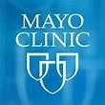













Proton Collaborative Group
25 treatment centers
Founded in 2009
27,000+ patient registry
8 Clinical Trials
Arizona and Minnesota

Slide 11
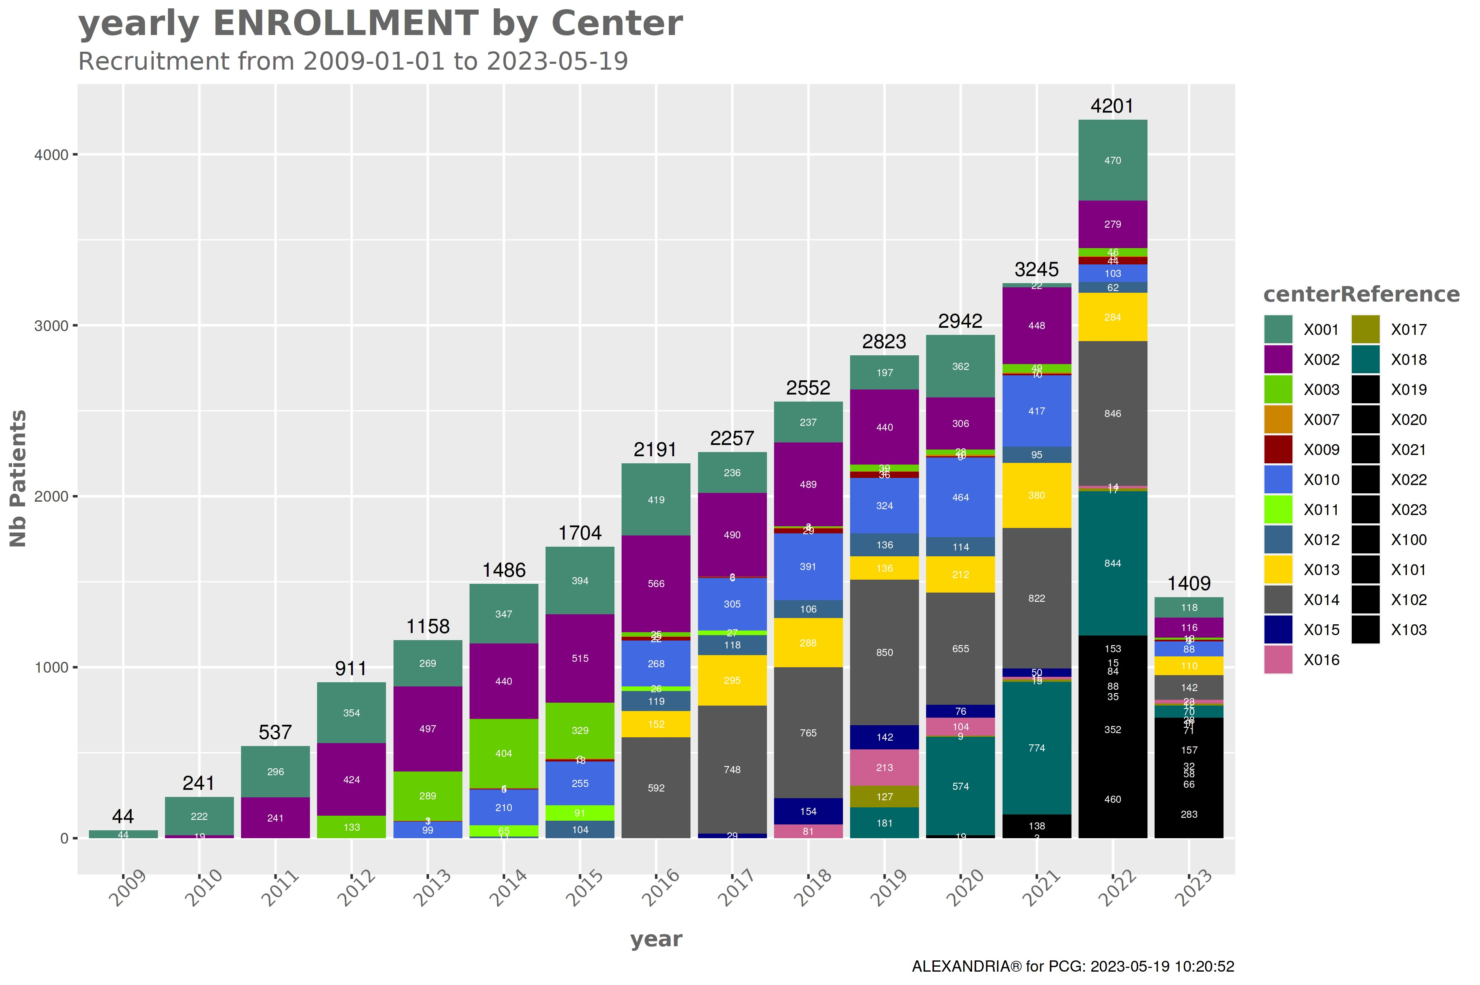
PCG Registry Accrual
Enrollment: 27,196
(as of June 5, 2023)

Slide 12
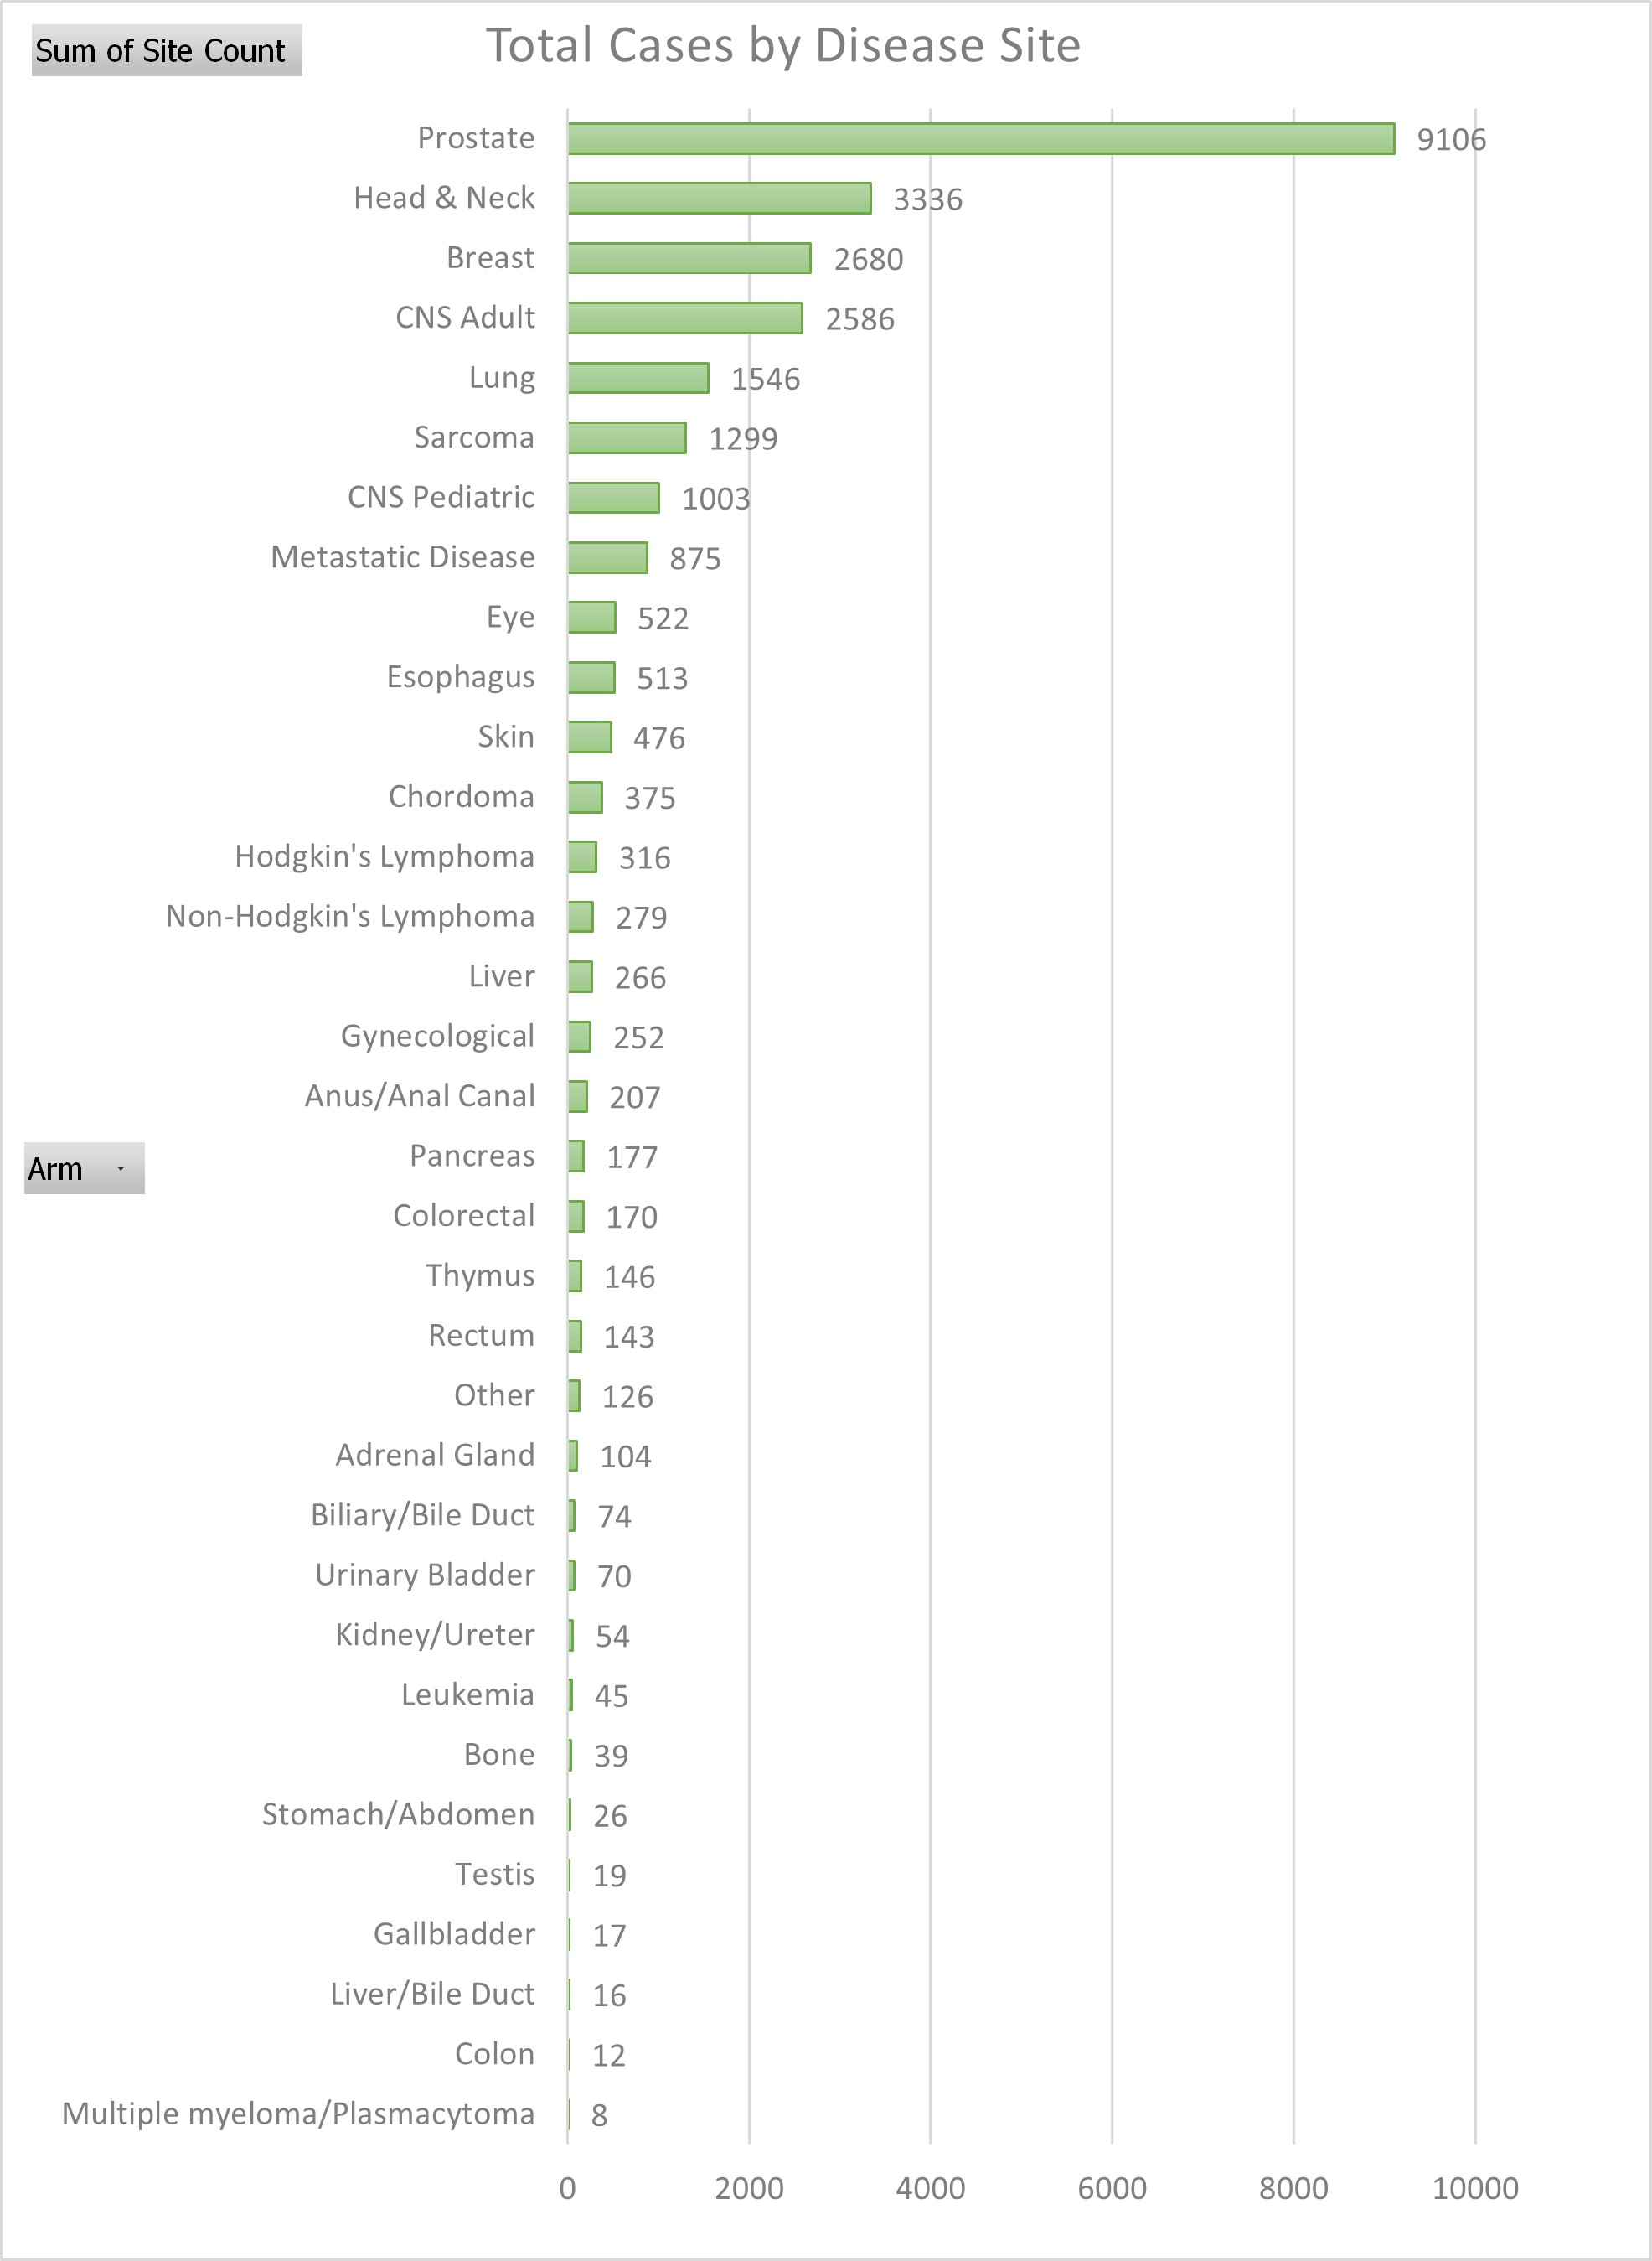
PCG Registry Disease Sites
Liver <1%

Slide 13
 | N (range/%)
Age (year), median | 68 (40-91)
Gender Male Female | 58 (70.7%) 24 (29.3%)
ECOG performance status 0 1 2 3 Not reported | 35 (42.7%) 29 (35.4%) 9 (11.0%) 4 (4.9%) 7 (8.5%)
Child-Pugh class, baseline A B C Not reported | 40 (48.8%) 14 (17.1%) 2 (2.4%) 26 (31.7%)
Tumor size (cm) Median <3 >3-5 >5-7 >7-9 >9 | 5.0 (1.2-19.0) 18 (22.0%) 20 (24.4%) 16 (19.5%) 7 (8.5%) 9 (11.0%)
Prior liver-directed therapy Partial hepatectomy Percutaneous ablation TACE Y90 External beam radiation thearpy | 28 (34.1%) 6 (7.3%) 5 (6.1%) 11 (13.4%) 3 (3.7%) 3 (3.7%)
Prior systemic therapy Yes No Not reported | 19 (23.2%) 62 (75.6%) 1 (1.2%)

Slide 14
 | N (range/%)
PBT prescribed dose (Gy) Median 37.5-45 50-65 67.5 72.3-90 | 59.3 (37.5-90) 17 (20.7%) 51 (62.2%) 12 (14.6%) 2 (2.4%)
PBT prescribed fractions Median 5 10-14 15 20-36 | 15 (5-36) 13 (15.9%) 7 (8.5%) 57 (69.5%) 5 (6.1%)
PBT prescribed BED₁₀ (Gy) Median 52.1-72 72.8-84 86.4-97.9 100-144 | 85.2 Gy (52.1-144) 20 (24.4%) 21 (25.6%) 32 (39.0%) 9 (11.0%)
PBT delivery schedule Once daily Every other day | 80 (97.6%) 2 (2.4%)
Proton therapy technique Pencil beam scanning Uniform scanning Not reported | 46 (56.1%) 27 (32.9%) 9 (11.0%)
Motion management Breath hold Abdominal compression Respiratory gating None Not reported | 15 (18.3%) 2 (2.4%) 1 (1.2%) 43 (52.4%) 21 (25.6%)

Slide 15
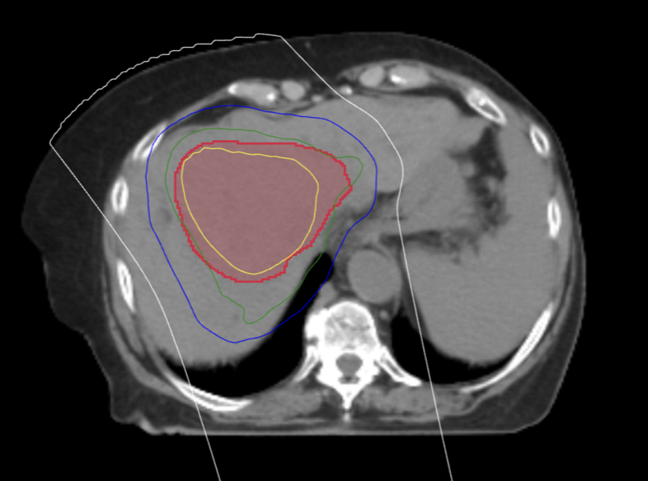
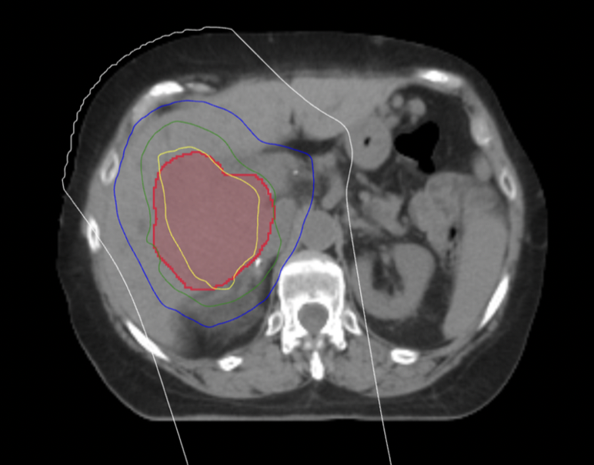
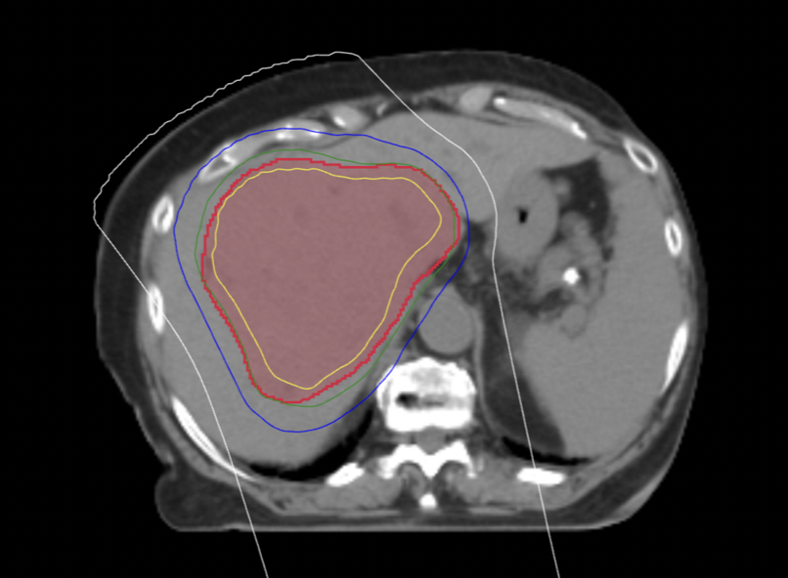

Slide 16
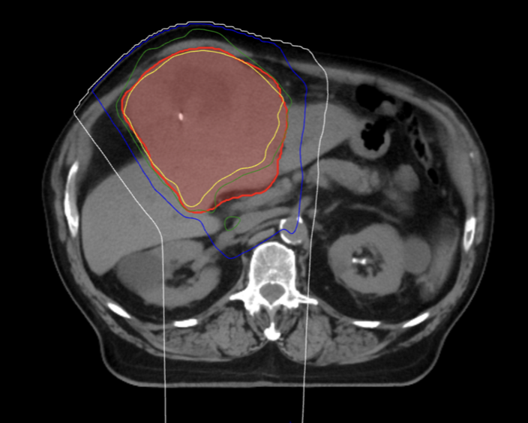
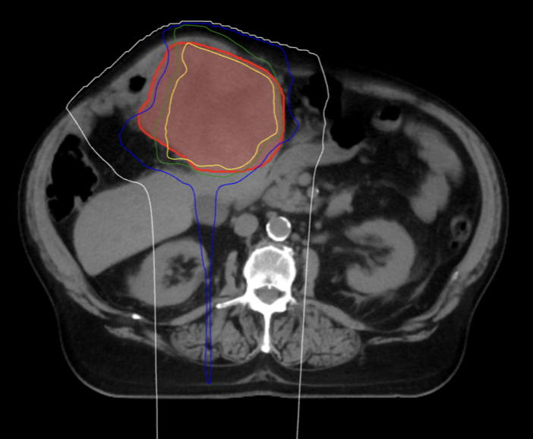
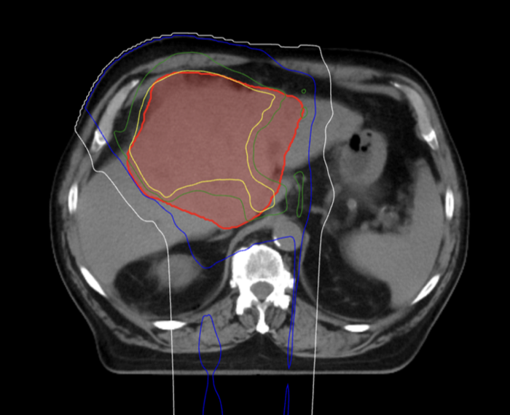

Slide 17
Liver minus PTV
Mean volume 1734.6 cc
Median mean dose = 9.4 Gy
Median V0 = 1254.3 cc
Median V5 = 1014.4 cc
Median V10 = 946.2 cc
Median V15 = 377.9 cc

Slide 18
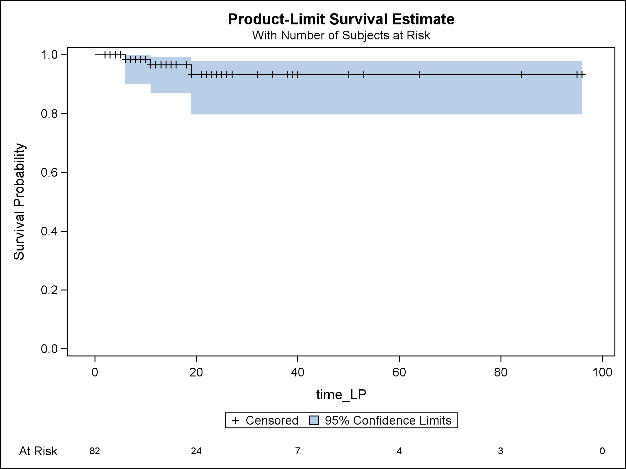
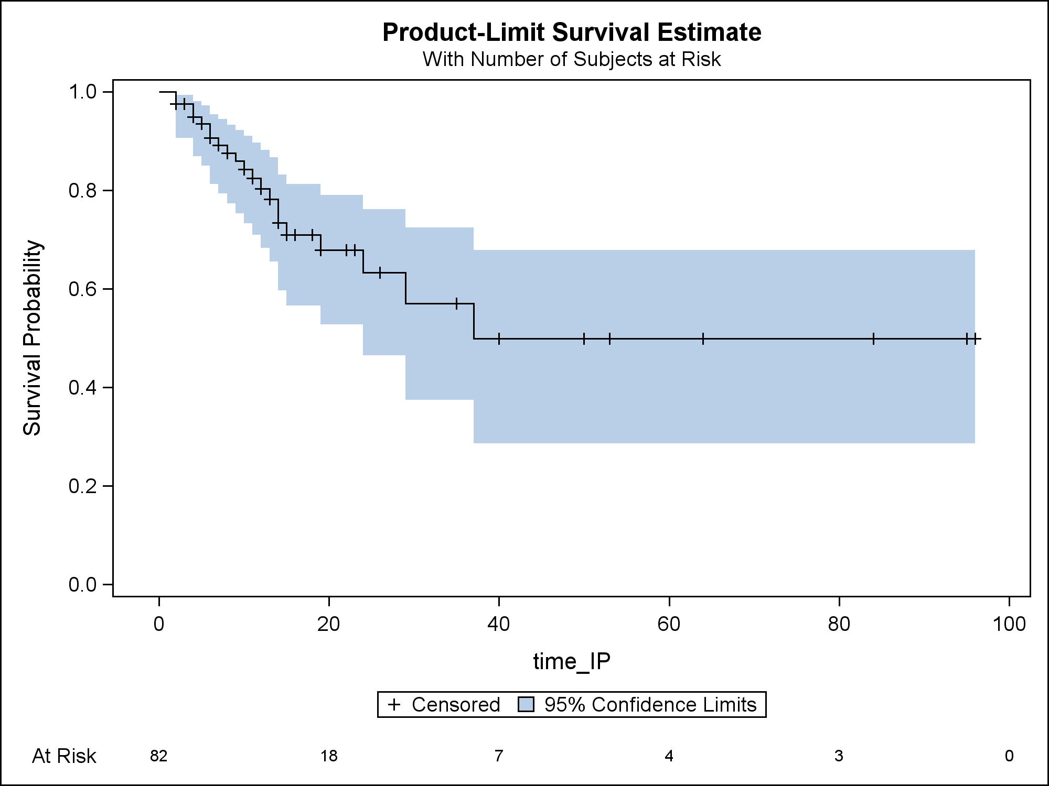
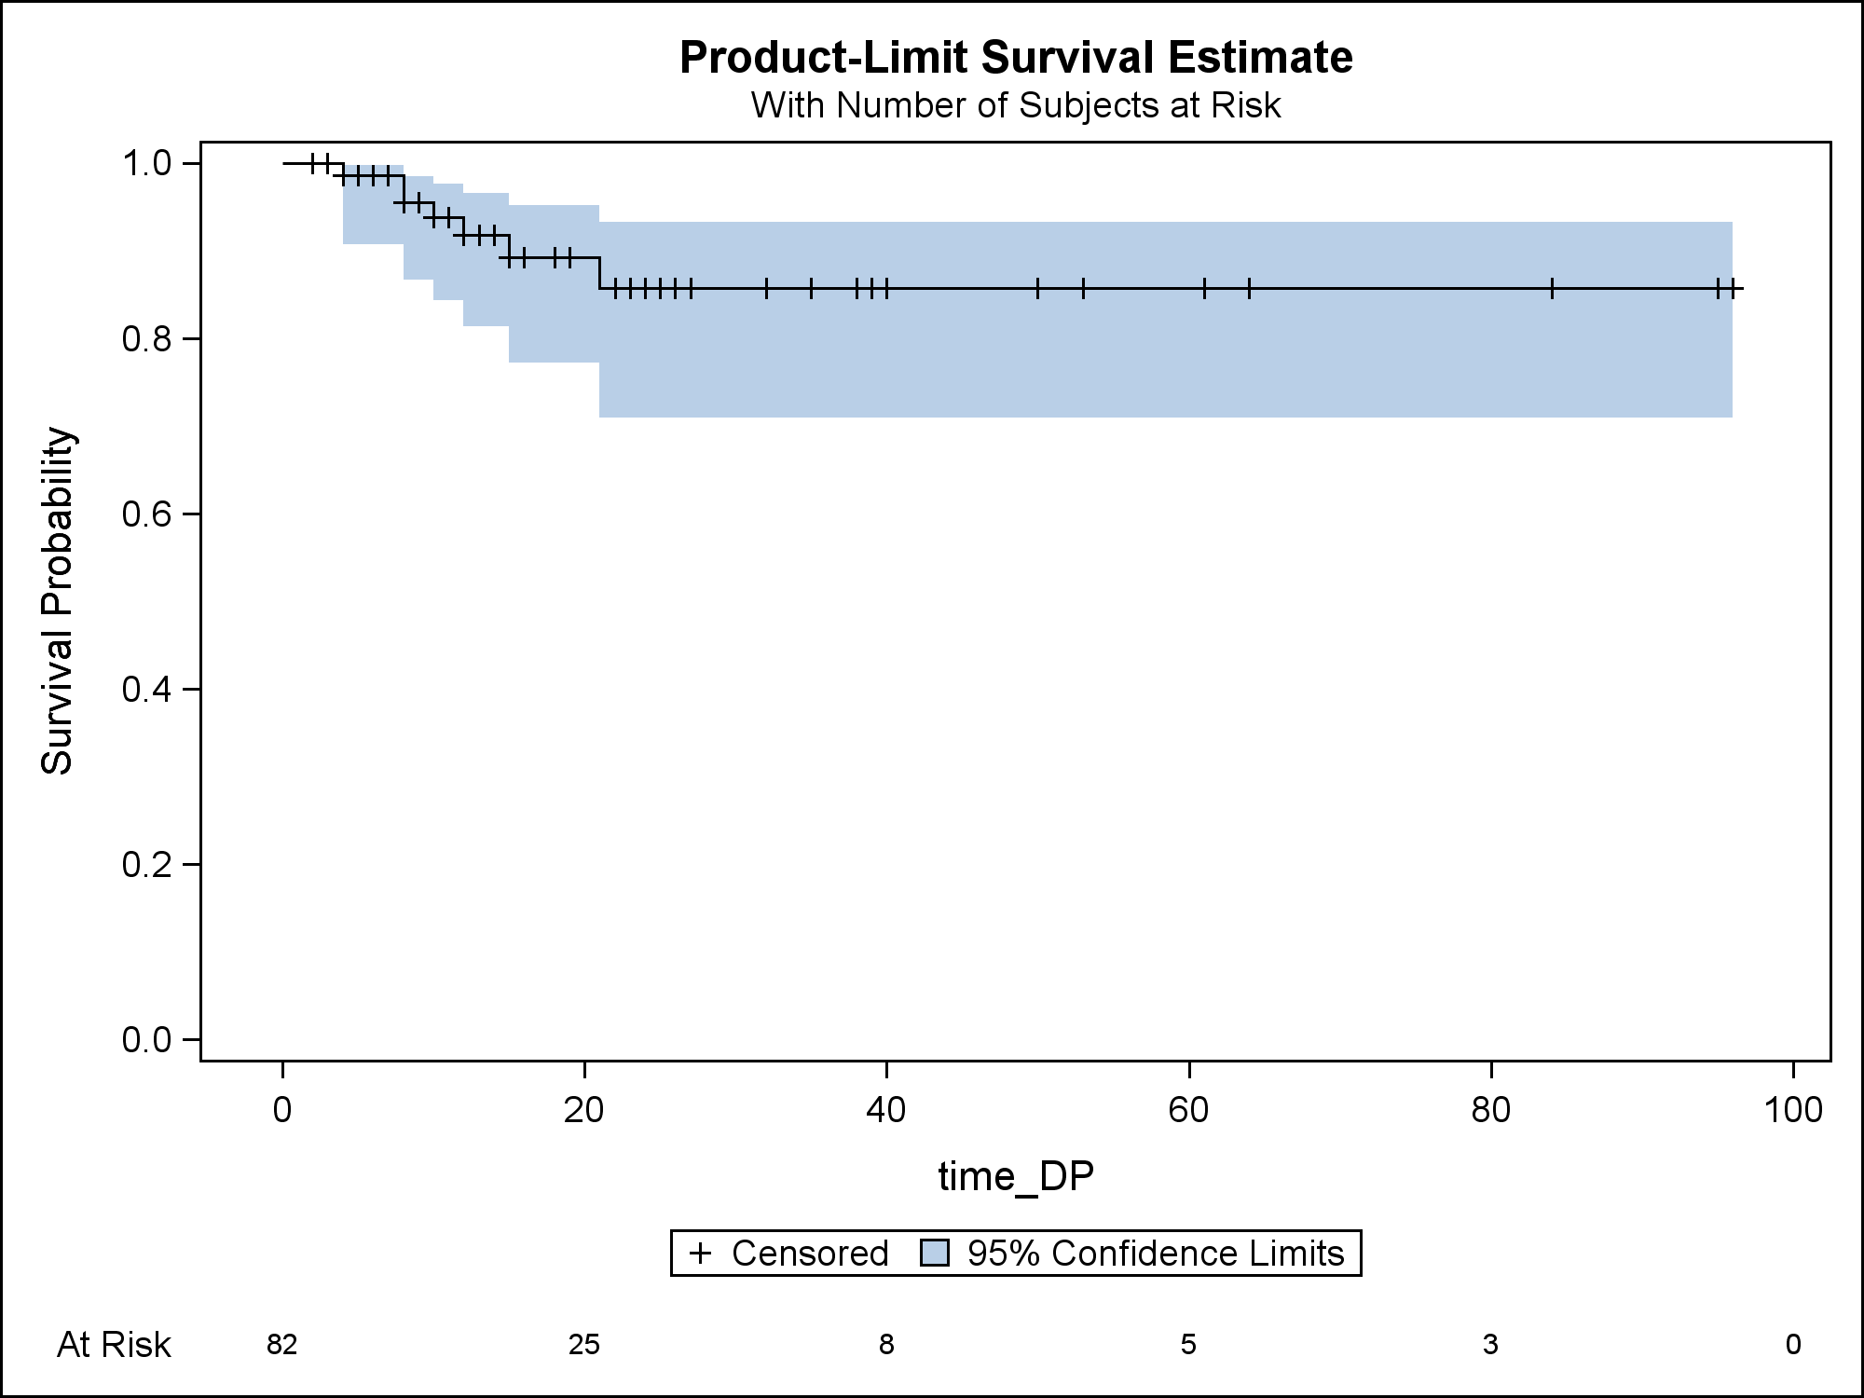
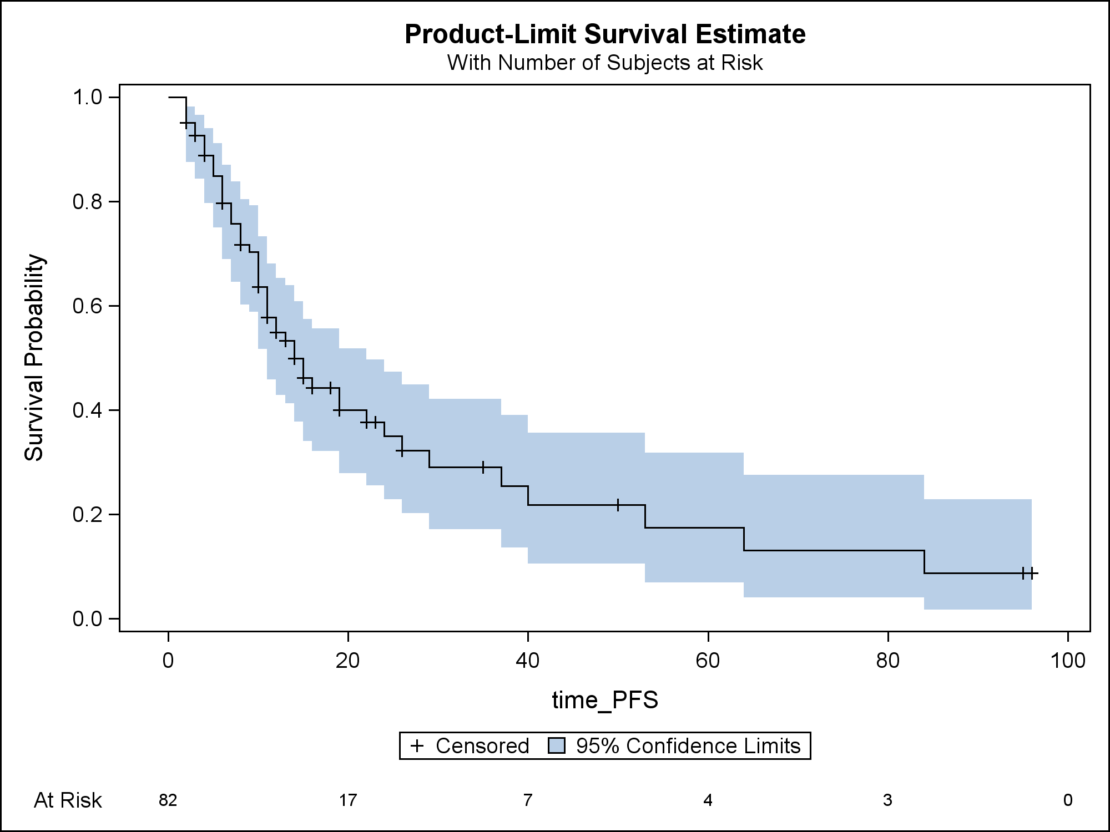
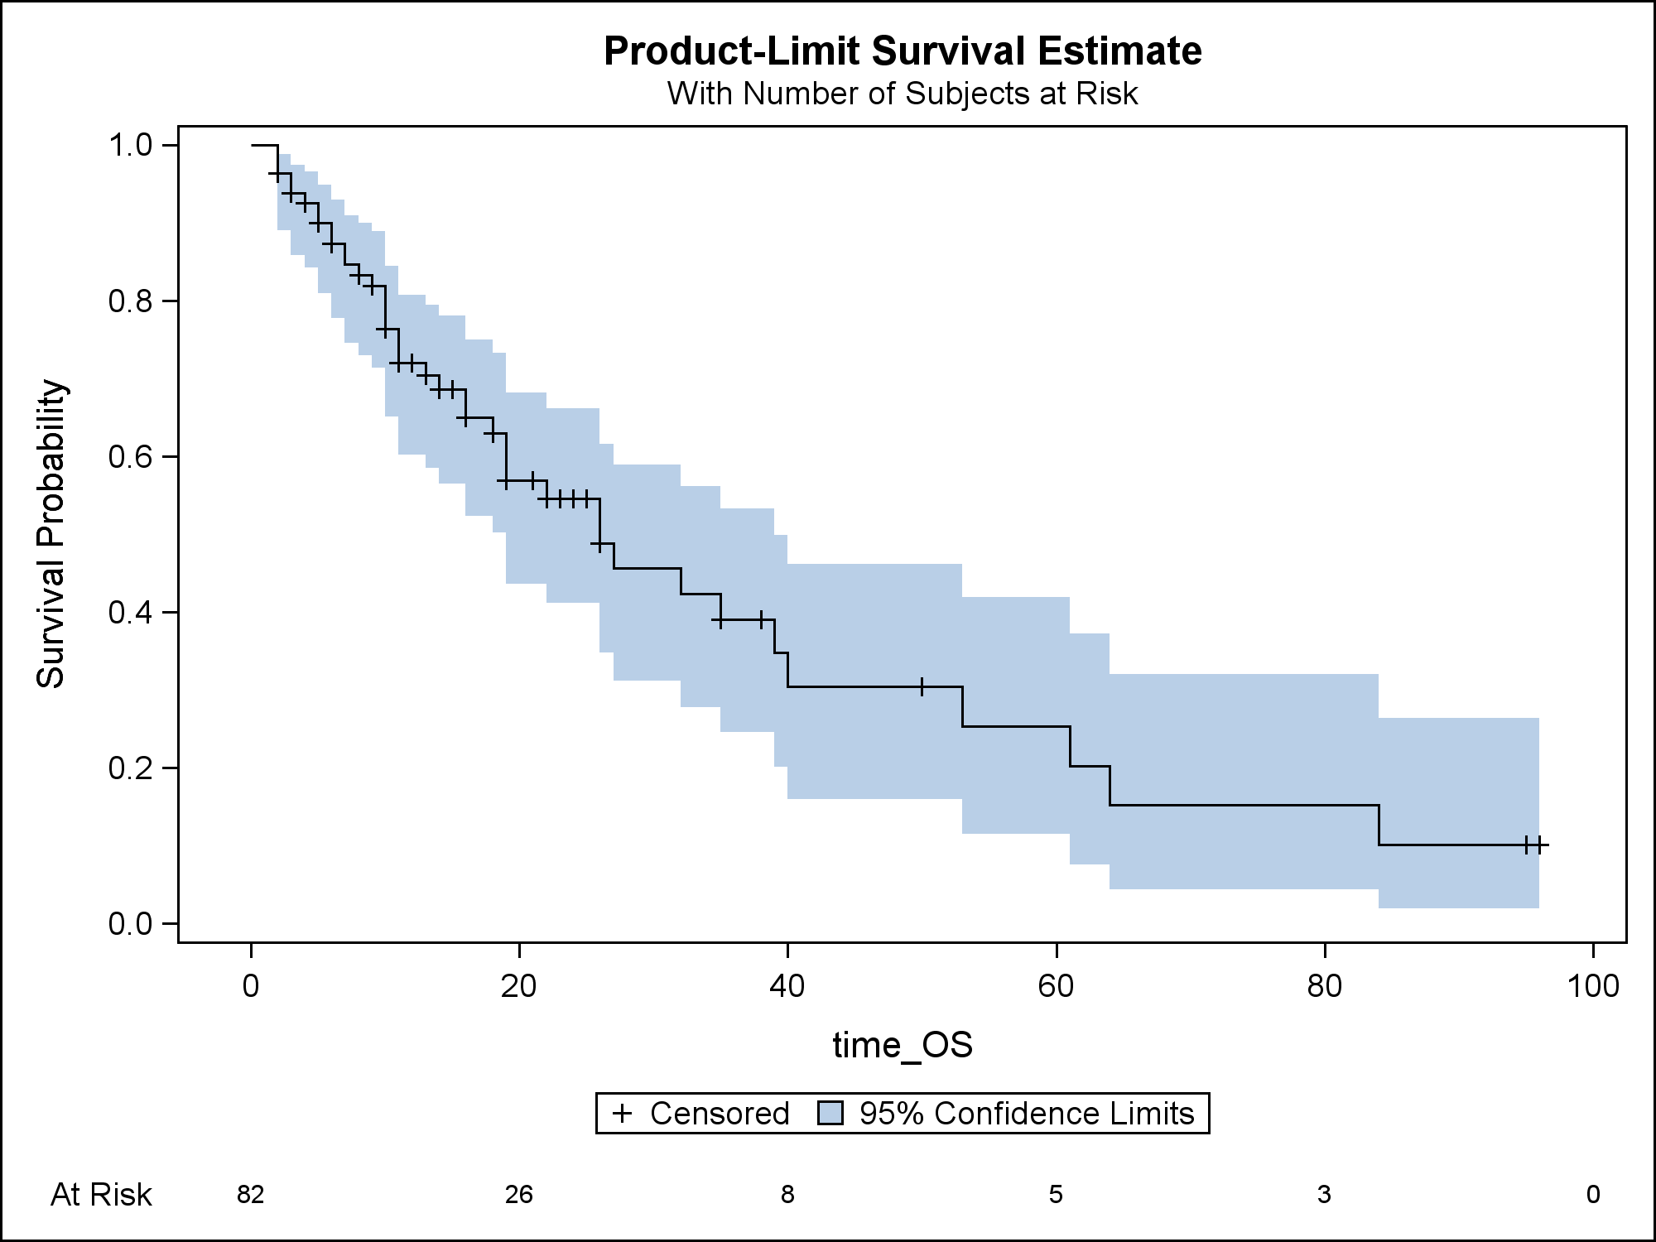
FFLP
FFIP
FFDP
Median not reached
2-year 93.4%
Median 37 months
2-year 63.3%
Median not reached
2-year 85.7%
PFS
OS
Median follow-up
  From diagnosis: 26 months
  From PBT start: 13.5 months
Median 14 months
2-year 35%
Median 26 months
2-year 54.6%

Slide 19
UVA/MVA - Overall Survival
Variable | UVA |  | MVA
 | HR (95% CI) | P value | HR (95% CI) | P value
Age group
<Median | Reference |  | Reference
≥Median | 2.03 (1.04-3.98) | 0.039 | 2.33 (1.11-4.91) | 0.026
Sex
Male | Reference
Female | 1.04 (0.48-2.26) | 0.916
Tumor size
<Median | Reference |  | Reference
≥Median | 2.56 (1.33-4.96) | 0.005 | 1.93 (0.92-4.08) | 0.084
ECOG
0 | Reference
≥1 | 1.84 (0.92-3.68) | 0.086
Child Pugh
A | Reference
B/C | 2.48 (0.98-6.27) | 0.056
Prior liver-directed therapy
Yes | Reference
No | 0.74 (0.37-1.50) | 0.403
Number of fractions
<Median | Reference
≥Median | 0.80 (0.36-1.78) | 0.584
Prescribed BED₁₀
<Median | Reference |  | Reference
≥Median | 0.48 (0.25-0.93) | 0.030 | 0.40 (0.17-0.90) | 0.028
Proton delivery technique
Uniform scanning | Reference |  | Reference
PBS | 0.48 (0.25-0.96) | 0.037 | 0.94 (0.41-2.15) | 0.891

Slide 21
67.5 GyE or 58.05 GyE in 15 fractions
2-yr PFS 35% (PCG)
2-yr PFS 39.9%
2-yr OS 54.6% (PCG)
2-yr LC 93.4% (PCG)
2-yr OS 63.2%
2-yr LC 94.8%

Slide 22
Conclusions
This is one of the largest Western studies of PBT for HCC
Dose-escalated moderately hypofractionated PBT achieves excellent FFLP with limited toxicity for HCC in a “real world” setting
Favorable outcomes were achieved despite include larger tumors up to 19 cm and patients with >CP-A baseline liver function
There is a need for novel treatment approaches to reduce out-of-field intrahepatic recurrence
Study limitations include short follow-up and lack of dosimetric data
Need to support the ongoing NRG GI003 randomized trial (PBT vs. photon therapy for HCC)

