Slide 1
Multi-Institutional Experience of Proton Therapy for Rhabdomyosarcoma and Ewing Sarcoma in the Proton Collaborative Group (PCG) Prospective Registry
Katherine Von Werne, Keitrina T. Mair, John Chang, Suzanne L. Wolden, Tamara Vern-Gross, Stephen Mihalcik, Young Kwok, Henry K. Tsai, Jing Zeng, Matthew D. Hall
Department of Radiation Oncology
Miami Cancer Institute
June 13, 2023

Slide 2
Disclosures
No financial disclosures
Matthew Hall, M.D., MBA
Dr. Hall is the voting member for Miami Cancer Institute on the Proton Collaborative Group (PCG) Executive Council (unpaid)
Dr. Hall is also the PTCOG-NA Treasurer and co-chair of the PTCOG Pediatric Subcommittee (unpaid)

Slide 3
Introduction
Rhabdomyosarcoma (RMS) and Ewing sarcoma are considered radiosensitive tumors
The selection of surgery and radiotherapy for local control is based on multidisciplinary decision-making
Several risk factors have been identified that impact local control with radiotherapy, including patient age, tumor size, and histology (ERMS vs. ARMS)
Chemotherapy intensity (Cyclophosphamide dose intensity in RMS and interval compressed chemotherapy in Ewing) also impact local control

Slide 4
Purpose
The aim of this study was to report on outcomes, acute toxicities, and the utilization of dose-escalation with proton therapy (PT) in RMS and Ewing sarcoma patients in the Proton Collaborative Group (PCG) prospective multi-institutional registry

Slide 5
Methods
Patients treated with PT for RMS/Ewing sarcoma were selected from the PCG database
Data were available from 10 institutions
This dataset was combined with our institutional database through 1/2023 with IRB approval
Clinical variables, demographics and outcomes were abstracted
Age, Chemotherapy, Dose, Field
Acute & Late treatment-related toxicities by Common Terminology Criteria for Adverse Events [CTCAE] v.4
Local control (LC) and overall survival (OS)
Statistical analysis was performed using descriptive statistics and Kaplan Meier in SPSS v26

Slide 6
Results
Demographics | All (%) | RMS | Ewing
Number of patients | 311 | 181 | 130
Age in years (Median) [IQR] | 9 [5-15] | 7 [4-12] | 14 [9-17]
Gender
Male | 178 (57%) | 109 | 69
Female | 132 (43%) | 72 | 60
Extent of Disease
Localized | 276 (89%) | 163 (90%) | 113 (87%)
Metastatic | 35 (11%) | 19 (10%) | 17 (13%)

Slide 7
Results
Demographics | All (%) | RMS | Ewing
Number of patients | 311 | 181 | 130
Proton Therapy Dose in CGE [Range] | 50.4 [45-68.4] | 50.4 [45-66] | 55.8 [45-68.4]
Proton Therapy Delivery
Pencil Beam Scanning | 124 (40%) | 49 (38%) | 75 (42%)
Passive Scatter/Uniform Scanning | 186 (60%) | 81 (62%) | 105 (58%)
Not Specified | 1 (<1%) | 0 (0%) | 1 (<1%)

Slide 8
Results
Median follow up: 2.2 years
Range: 0.2-12.3 years
Two-year overall survival rates were
81.1% (95% CI: 73.7%-88.5%) for RMS and
79.1% (95% CI: 71.7%-86.2%) for Ewing sarcoma

Slide 9
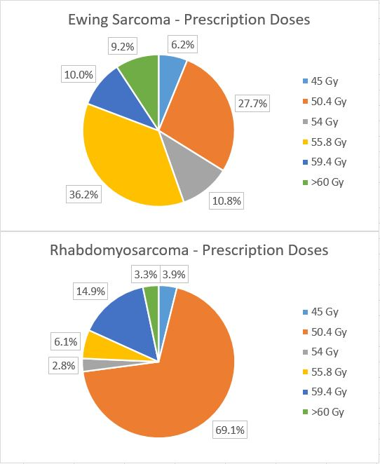
Dose-Escalated Radiotherapy Utilization
27.1% of RMS patients received dose-escalated PT (defined as >50.4 Gy).
19.2% of Ewing sarcoma patients received dose-escalated PT (defined as >55.8 Gy)

Slide 10
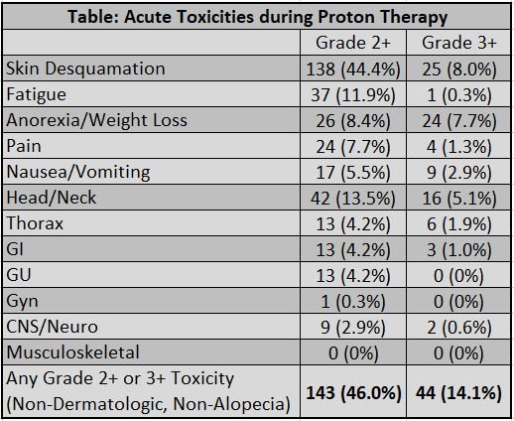
Acute Toxicities

Slide 11
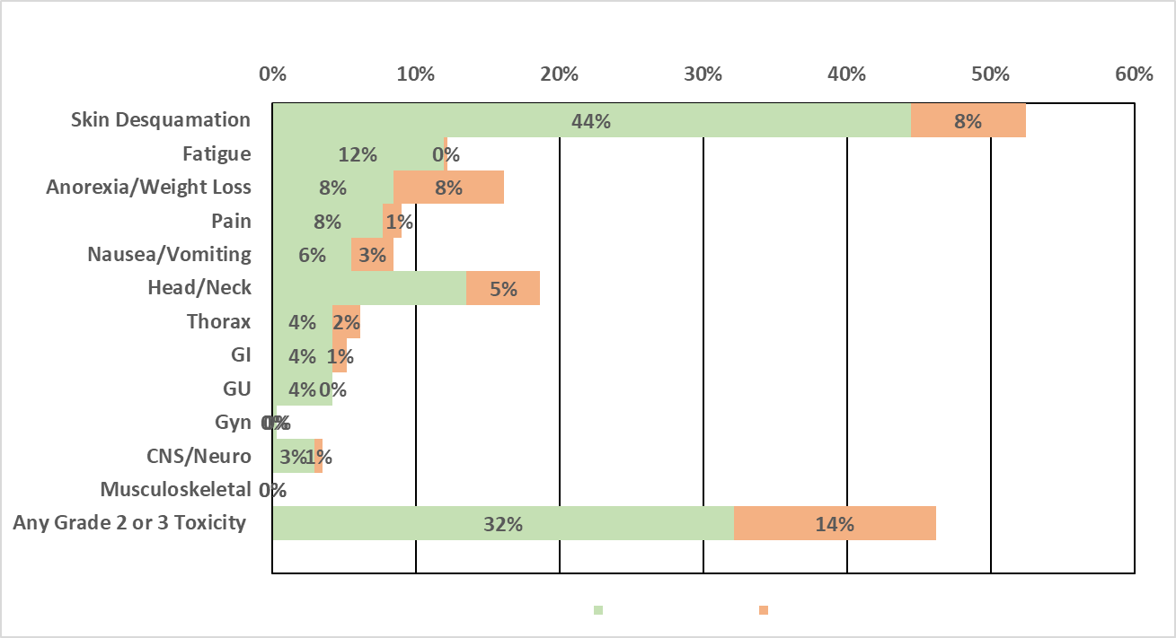
Grade 2-3 Acute Toxicities
Grade 2
Grade 3
The most common Grade 2+ toxicities were head/neck mucositis (13.5%), fatigue (11.9%), weight loss (8.4%), and pain (7.7%).
The most common Grade 3 toxicities were: weight loss (7.7%) and head/neck mucositis (5.1%)

Slide 12
Results
Grade 2-3 toxicities were compared between standard dose and dose-escalated cohorts
Skin desquamation and head/neck toxicities were marginally higher with dose-escalation, but all other toxicities were comparable
Complete local control outcomes will be reported at ASTRO 2023 with additional follow-up data provided from participating PCG sites and stratification by treatment year and histology
Local control for RMS seemed to improve with dose-escalated PT (magnitude ~13%)
High local control rates were observed for Ewing sarcoma with both standard dose and dose-escalated PT

Slide 13
Conclusions
In this multi-institutional study, dose-escalated PT was used in 19.2% of Ewing sarcoma and 27.1% of RMS patients
Excluding skin, alopecia, and hematologic toxicities, 46.0% of patients developed any acute grade 2+ toxicity and 14.1% developed any grade 3 toxicities
Local control outcomes will be reported at ASTRO 2023, but our findings suggest that dose-escalated PT may improve outcomes in RMS without unacceptable increased toxicity
Long-term outcomes for disease control and toxicity are needed to fully assess the benefits and risks of dose-escalated radiotherapy in RMS/Ewing sarcoma in light of emerging results from cooperative group trials

Slide 14
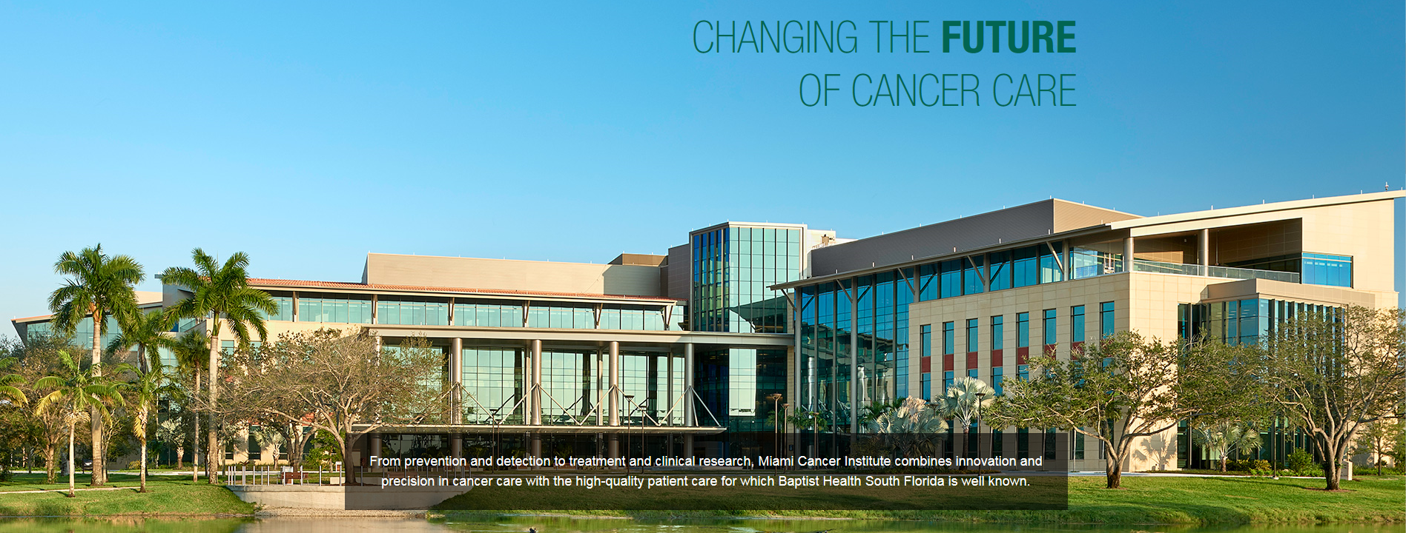
Contact
Matthew D. Hall, M.D., MBA
MatthewHa@baptisthealth.net
Miami Cancer Institute

